Slide 1
Concord NC
Name
Course Title
Date

Slide 2
Site Overview/ Existing Conditions
Conservation lands within the major river drainages represent the majority of protected lands in Concord.
The area is predominantly flanked by rural communities whose rustic character is being threatened by the expanding urbanization.
Many of portions of the area lack water and sewer service, thereby predisposing it to water pollution.
There is storm water runoff that erode soil, especially in areas cleared for development.
Notes:
Concord contains six major sub watersheds with the Merrimack River Drainage sub watershed occupying most of Concord. Conservation lands within the major river drainages represent the majority of protected lands in Concord. The existing conditions in the city were analyzed to gain understanding of the features that need development and improvement. The area is predominantly flanked by rural communities whose rustic character is being threatened by the expanding urbanization. Many of portions of the area lack water and sewer service, thereby predisposing it to water pollution. The environmental issues in the area are mostly linked to soil and water quality. There are concerns about the water quality, which has been degraded by the sediments from the increasing storm water runoff that also erode soil (City of Concord, 2017). This is especially happening in areas that have been cleared for development purposes

Slide 3
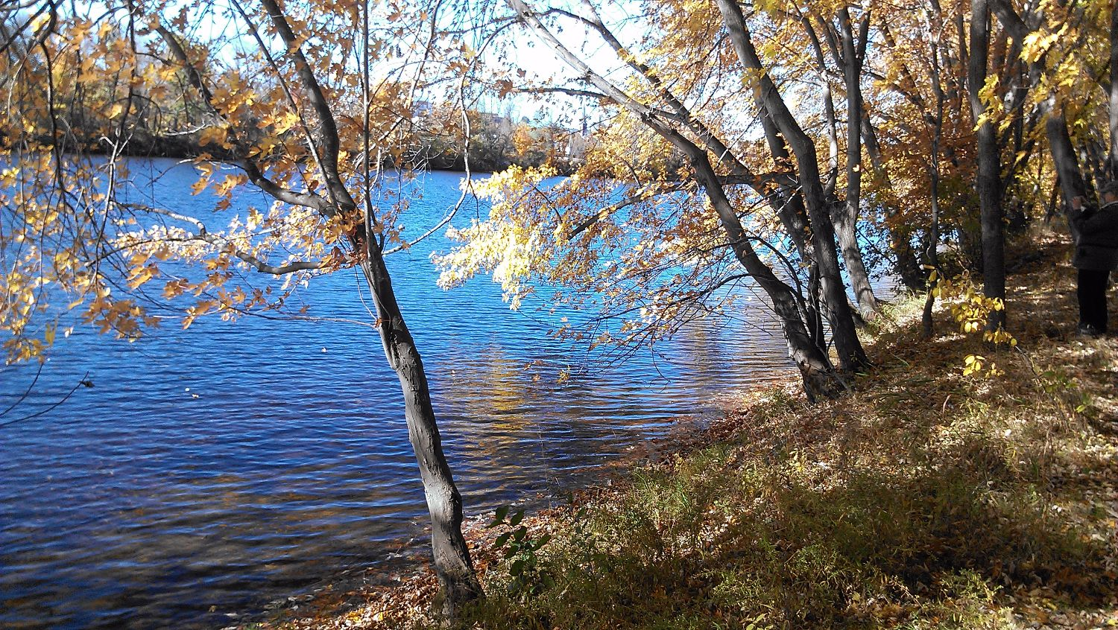
Notes:
Merrimack River Drainage sub watershed

Slide 4
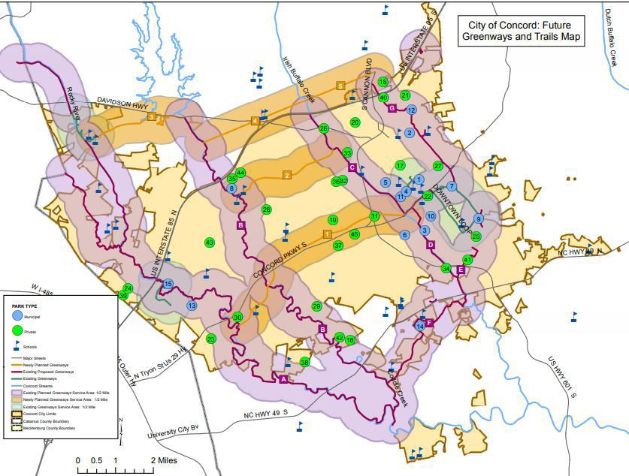
Notes:
City leaders have a long-term objective that will connect areas in Concord through greenways, multi-use paths, bike lanes and sidewalks.

Slide 5
Soil and Geotechnical Conservation of CONCORD NC
The soil and geotechnical conservation at Concord is highly variable.
It is being administered by the Cabarrus Soil and Water Conservation District.
The agency encourages informed and responsible use of the land and all its natural resources.
It provides services for the evaluation of soil sample results.
A board of supervisors convene monthly to discuss local soil and water conservation priorities based on the needs of the city.
Notes:
The soil and geotechnical conservation at Concord is highly variable. While most of the conservation easements are being held by non-governmental organizations, the city has purchased vast parcels of land for conservation and only allows legal use. Soil and Geotechnical conservation in the city is being administered by the Cabarrus Soil and Water Conservation District. The agency encourages informed and responsible use of the land and all its natural resources. Besides, it has enacted tailored programs to sensitize land users, owners, institutions, and community groups on the planning, application, and maintenance of sound conservation and appropriate land use practices. While the agency does not perform soil testing, it provides services for the evaluation of soil sample results. Also, free soil testing boxes are availed to citizens through the Agronomic Division of North Carolina Department of Agriculture and Consumer Services (Thompson, 2020). A board of supervisors convene monthly to discuss local soil and water conservation priorities based on the needs of the city. These priorities are addressed through the implementation and installation of best management practices that conserve natural resources within the city.

Slide 6
Project Phasing of CONCORD NC
The city has installed plans to conserve land and its natural resources.
The areas that are largely unprotected and undeveloped have been earmarked for conservation.
The selection criteria for development areas take into consideration the physical diversity, i.e. variety of geological and hydrological features.
Considerations are made regarding an area’s potency to provide essential services such as drinking water, food products, flood control, and timber products.
Notes:
The city has installed plans to conserve land and its natural resources. The areas that are largely unprotected and undeveloped have been earmarked for conservation. These areas have been categorized according to the city’s ecoregion and assigned geographical place names based on their locations. The delineation of these areas was driven by a series of selection criteria that captures a range of values that differentiate developed areas from undeveloped ones. This process has allowed the city’s conservation board to prioritize the conservation of open space lands. The selection criteria take into consideration the physical diversity, i.e. variety of geological and hydrological features as well as the general quality and condition of the area (City of Concord, 2017). Besides, considerations are made regarding an area’s potency to provide essential services such as drinking water, food products, flood control, and timber products.

Slide 7
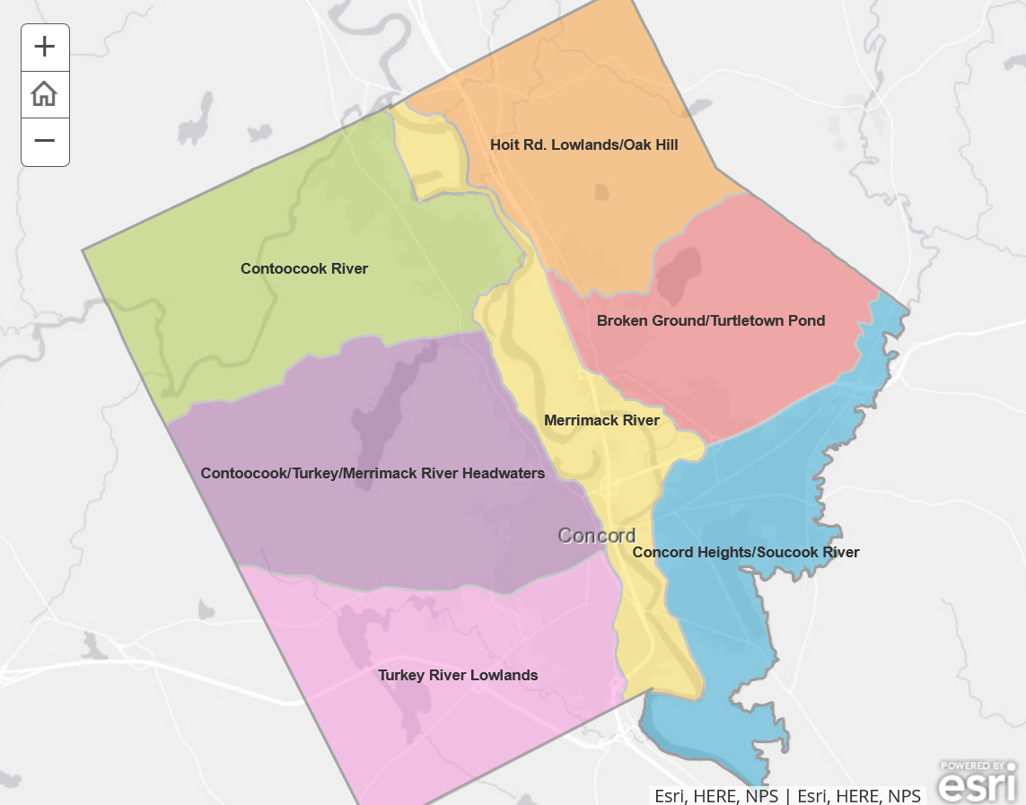
Notes:
Ecoregions at Concord.
Thinking on an ecoregional level helps us to understand the specific physical (i.e., climate, landforms, and soils) and biological features (i.e., ecosystems, natural communities) that define each ecoregion, helping to develop landscape level conservation open space planning.

Slide 8
Open Space of CONCORD NC
The open space in Concord is grouped into two categories: the undeveloped land that is relatively in its natural state and the recreation areas such as parks and trails.
Among its open spaces for conservation include land trust properties, state parks and forests, as well as areas protected by conservation easements.
Some city-owned and private open spaces are legally protected from development.
Notes:
The open space in Concord is grouped into two categories: the undeveloped land that is relatively in its natural state such as farm lands, wetlands, and forests, and the recreation areas such as parks and trails. However, developed areas such as golf areas and cemeteries are excluded from the regions marked as open space. Among its open spaces for conservation include land trust properties, state parks and forests, as well as areas protected by conservation easements. Some city-owned and private open spaces are legally protected from development. The management of the city parks is done by the city’s Parks and Recreation Department and these are some of the open spaces that are protected from development (City of Concord, 2017). Besides, some of the rustic trails in the city have been marked for development in a bid to address the need for connecting the city to regional recreation trails.

Slide 9
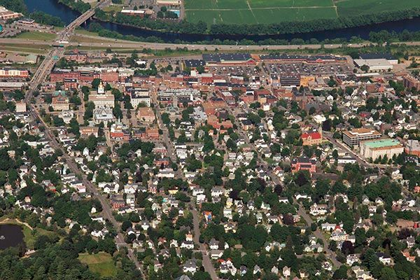
Notes:
Trails in the open spaces of Concord city

Slide 10
References
City of Concord. (2017, June). Conservation and Open Space Plan. Retrieved from http://www.arcgis.com/apps/MapJournal/index.html?appid=413f41065dc34f4a874525140e20d57e
Thompson, A. (2020). Concord making push to connect city through greenways, multi-use paths. Independent Tribune. Retrieved from https://independenttribune.com/cit/concord-making-push-to-connect-city-through-greenways-multi-use-paths/article_d7faa9fc-9246-50da-8058-0522a089ee3e.html

